Slide 1
REDX Parking Management System
BY:
Swastik Patro
Varun Agarwal
Ankit Agrawal
Shweta Tiwari
Rutuja Sutar
Naman Madharia

Slide 2
Contents
Introduction
Motivation
Technical Requirements
Stakeholders
Idea Implementation
References

Slide 3
Introduction
Many people come to visit the wari from far locations by different kind of transportation so parking is a problem for them
It should be easy for visitors to know at which location parking is available
Parking is one factor because of which traffic increases and people face problem

Slide 4
Motivation
Many people visit the temple by vehicles such as in buses ,trucks and cars so it is a big problem for them to where to park their vehicles and this also causes traffic.
so we came up with an idea in which we use image processing in AI which tells about is there any space remaining or not and if some space is available then is it sufficient for car or for a bus .
We can do it by placing camera at a defined altitude so that it can process the vehicles and tell for the vacant places.

Slide 5
Technical Requirements
Camera /webcam: To capture image and detect the empty or full place in parking slot.
Quad copter: To lift the camera to the desired height which will help to capture full view of slot.
Display monitor: To display the status of parking slot to the users.
Wireless data transferring module: To connect modules of the project wirelessly.
Batteries: To provide electric energy to the system.

Slide 6
Stakeholders in “Wari”
Municipal Corporation: They will grant us access us and provide us space to implement our prototype.
Camera Shop Owner: We can get good camera from them which will give better frame rates than ordinary cameras
Electrical Shop Owners: We can get proper wiring setups ,pcbs ,connectors ,convertors and display from them.
Localities: We might need some volunteers for the prototype for that we can get help from localized.
MIT AERO Club : They have drones ,gimbles and FPV on which we can add our system and deploy our prototype.

Slide 7
Idea Implementation
In this project, a robust algorithm is designed taking into consideration the joined capabilities of ,
Gaussian blurring
Truncate thresholding
Canny edge detection
Contour Detection

Slide 8
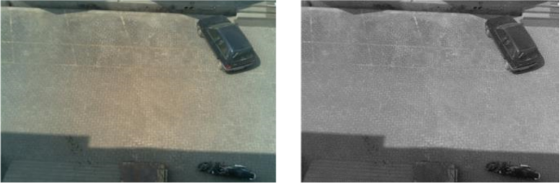
Figure 1A. input Image Figure 1B. Image after Gaussian Blur

Slide 9
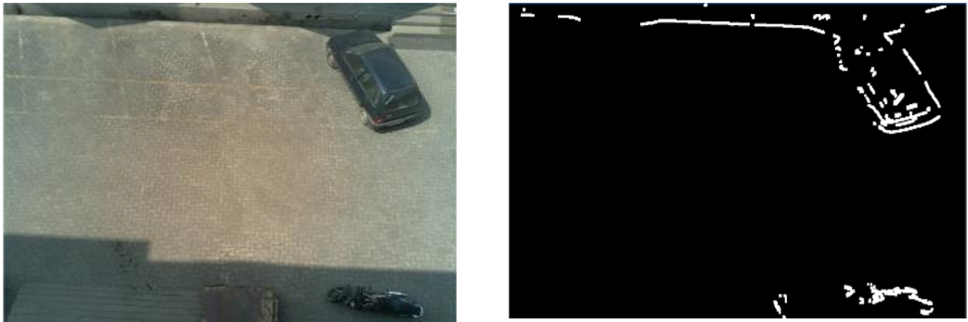
Figure 2A: input Image Figure 2B: Binary Image

Slide 10

Figure 3A: Image before noise removal
Figure 3B: image after noise removal

Slide 11

Figure B Image After Cropping
Figure 4A Image before Cropping

Slide 12
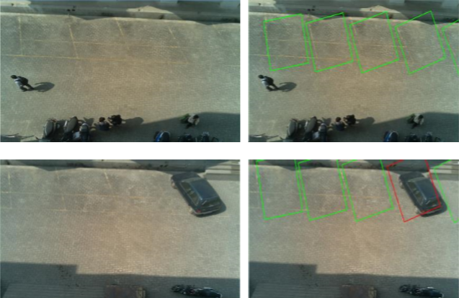
Figure 5A. INPUT A
Figure 5B. INPUT B

Slide 13
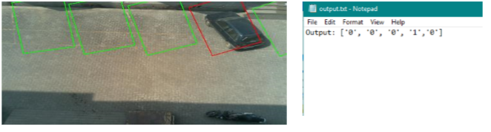
Figure 6B Data stored as .txt file
Figure 6A displays the output

Slide 14
References
https://www.parking.org/2018/01/04/artificial-intelligence/
https://www.bosch.com/stories/artificial-intelligence-community-based-parking/
Qi Luo, Student Member, IEEE, Romesh Saigal, Robert Hampshire and Xinyi Wu, “A Statistical Method for Parking Spaces Occupancy Detection via Automotive Radars”, Vehicular Technology Conference (VTC Spring), 2017 IEEE 85th
Nastaran Reza Nazar Zadeh, Jennifer C. Dela, “Smart Urban Parking Detection System”, 2016 6th IEEE International Conference on Control System, Computing and Engineering, 25-27 November2016, Penang, Malaysia

Slide 15
THANK YOU

Slide 16

ANY QUERIES??

